Slide 1
Your building
Our solution
You
110
←Your building
110
This month
Today
This year
Reserve
Report
Reserve
Report

Slide 2
←Your building
110
This month
This year
Reserve
Report

Slide 3
Your building
110
←Your building
110
Your building
This year
This year
110
History
This month
2013
2014
2015
History
2016
This year
Reserve
Report
Reserve
Report
This year

Slide 4
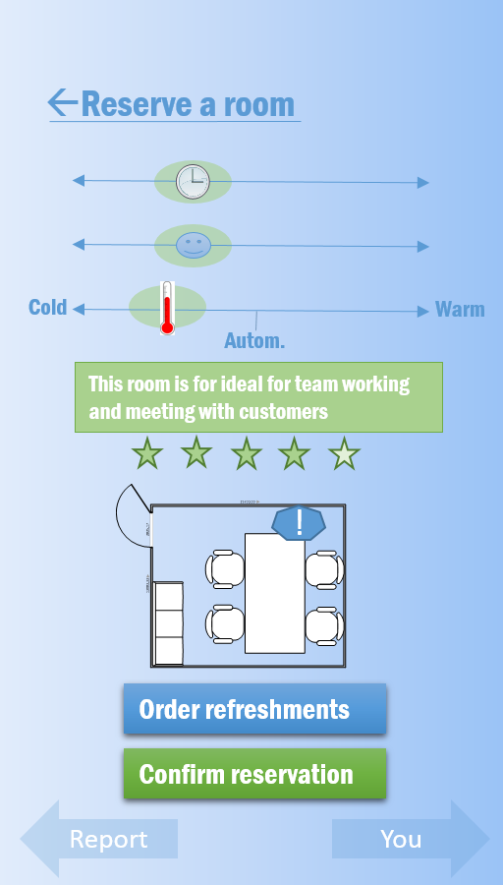

Reserve a room
←Reserve a room
Cold
Warm
Autom.
This room is for ideal for team working and meeting with customers
!
Only HDMI connection to display
Order refreshments
Confirm reservation
Report
You
Report
You

Slide 5
Report
+3
Report
+3
Report
+3
Choose location if other than current
Choose urgency of the issue
!
!
!
Depiction of the issue…
Depiction of the issue…
Depiction of the issue…
Send report
Send report
Send report
Earlier reports
Earlier reports
Earlier reports
You
Reserve
You
Reserve
You
Reserve

Slide 6
←Report Status
=8
←Report Status
=8
Report
+3
This issue has been fixed and maintenance person found it urgent.
!
!
!
+2
+2
Depiction of the issue…
Take a depictive picture of the issue
Send report
You
Reserve
You
Reserve
Earlier reports
You
Reserve

Slide 7
←Report Status
=8
←Report Status
=8
110
This issue has not yet been assigned
Today
This issue is assigned and under process
You used public transportation. Nice! +1
!
!
+2
+2
You
Reserve
You
Reserve
Reserve
Report

Slide 8
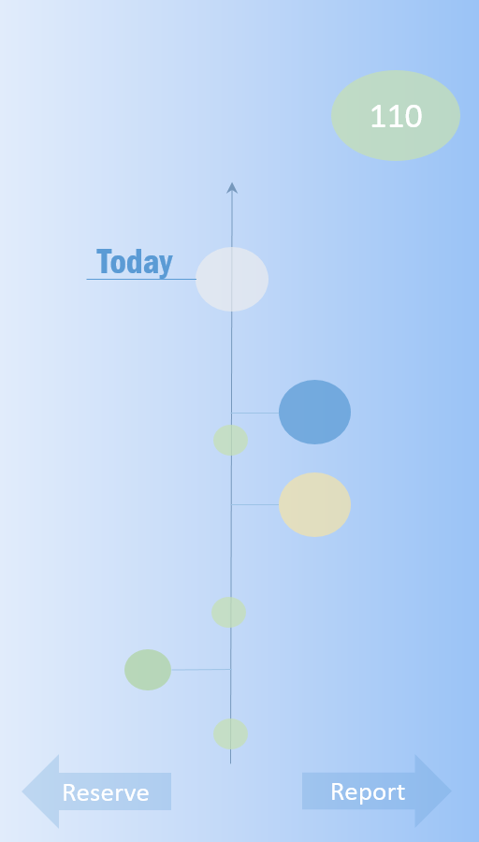

110
110
How you feeling at the moment?
Today
Today
Not great
Amazing
Too
dark
Perfect
Too
bright
How was your reservation for the U362 on Mon 20.11.2016?
Space:
Refreshments:
Cold
Perfect
Warm
Not
fresh
Fresh
Draft
Comment…
+2
Submit +2
Reserve
Report
Reserve
Report

